Slide 1
FPGA Implementation of an OFDM Modem
Laboratório de Telecomunicações
Departamento de Engenharia Elétrica
Universidade Federal do Espírito Santo
Tonny M. Siqueira and Evandro O. T. Salles
Why OFDM (Orthogonal Frequency Division Multiplexing)?
  Fully digital modulation
  ~50% bandwidth reduction
  Multipath robustness and ease channel equalization
  Applications: Digital TV, ADSL, VDSL, PLCC, Wi-Fi, UWB
Why FPGA?
  Rapid prototype design flow
  FPGA vs. DSP for Wi-Fi implementation
    Wi-Fi needs 15 GOPS
    Texas Instruments C64x DSP less than 5 GOPS
    Virtex can support up to 20 GOPS

Slide 2
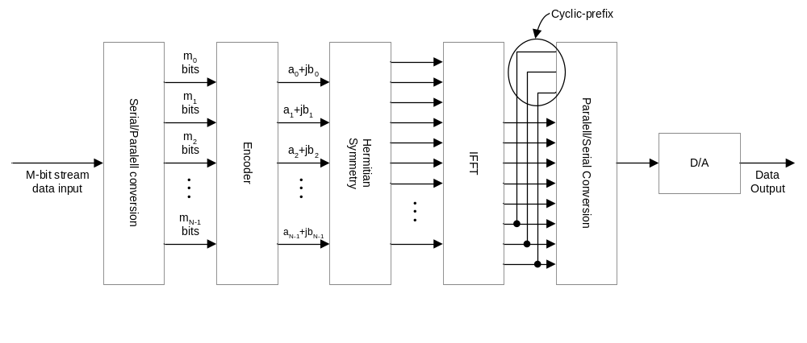
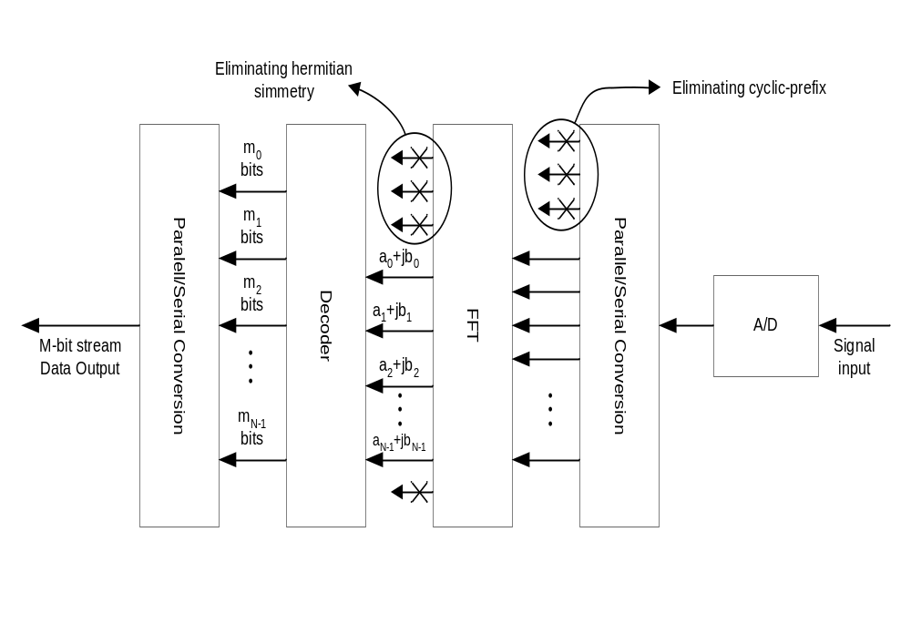
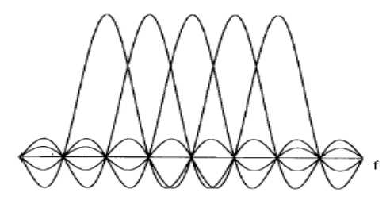
OFDM System
Transmitter
Spectral Compression
f
Orthogonality
between subcarriers
OFDM Spectrum
Receiver

Slide 3
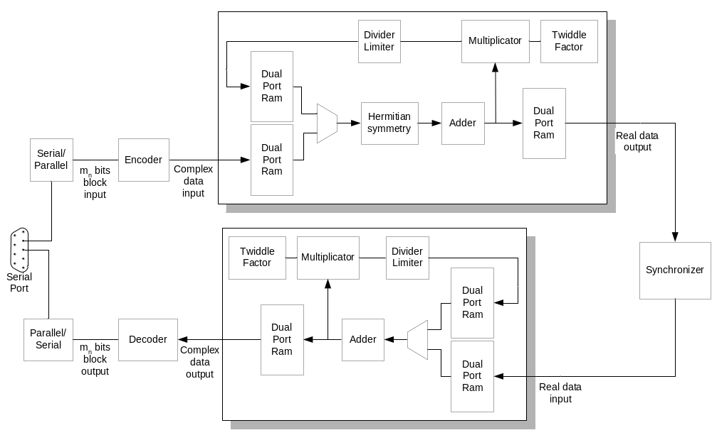
Our approach to OFDM system
Implemented through CORDIC
(Coordinate Rotation Digital Computer)
Efficient and flexible FFT implementation
RTL Controller Circuits optimized for 64-point FFT (i.e. up to 31 subcarriers)

Slide 4
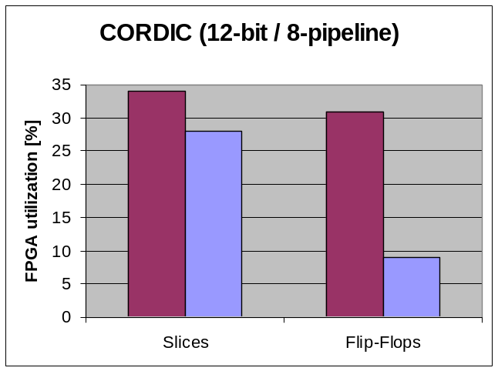
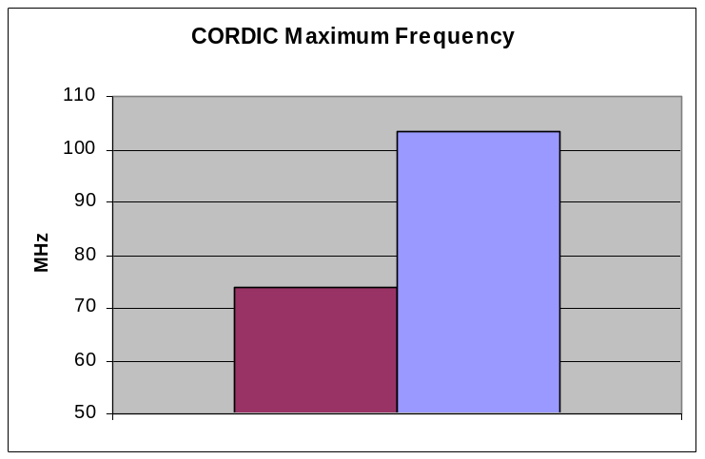
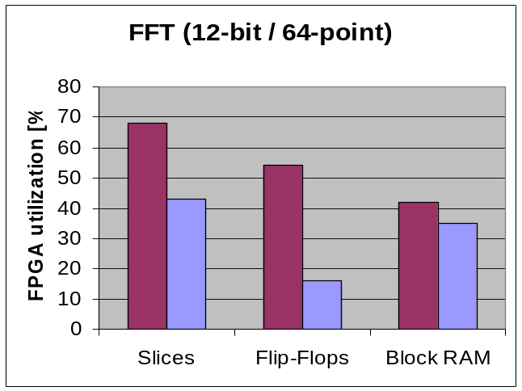
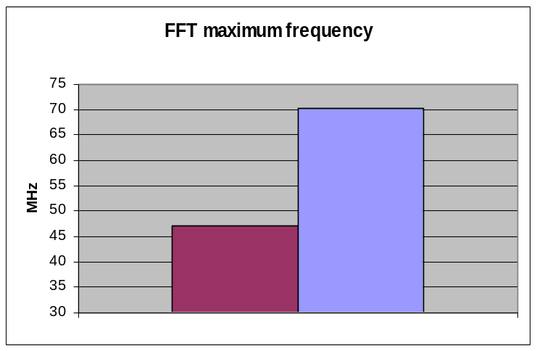
Design improvements
Coregen Our approach

Slide 5
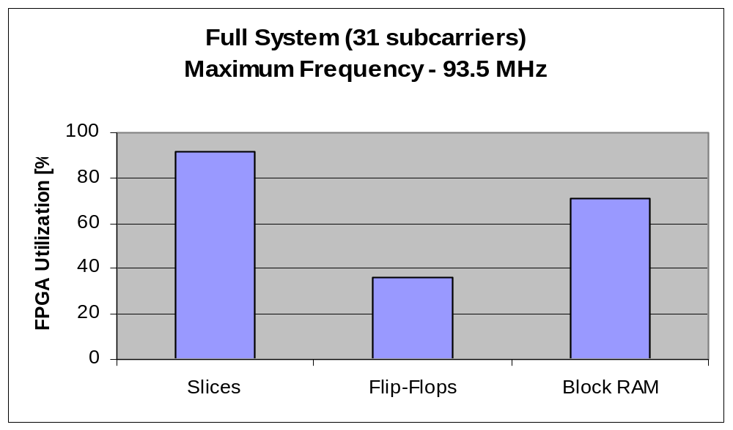
FPGA utilization
(Final design - Spartan IIE)
Modem capacity: 12 bit / 64 point FFT, up to 14.3Mbps at 50 MHz clock.
Future Work: Synchronization, Error Corrections (TCM, Interleaving, Turbo Coding), Other basis different from DFT (ELT – Extended Lapped Transform, WPM – Wavelets Packets Modulation).

